Slide 1
Dublin Lockdown Reflections
Student reflections on their lockdown experience in early 2020

Slide 2
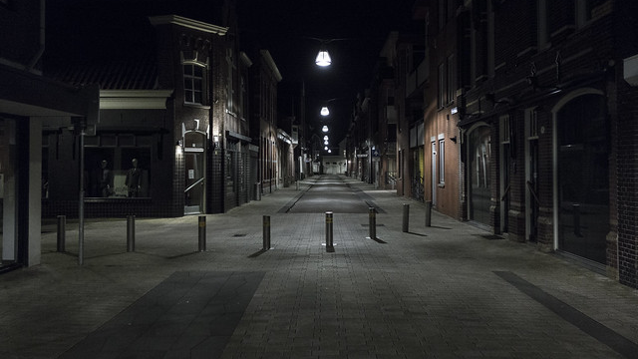
Introduction
In March 2020 all schools and colleges in Ireland were closed to combat the spread of COVID 19.
Lots of adult learners in Coolock/Darndale Adult Literacy Service were impacted by this big change in circumstances.
Although great efforts were made to continue learning we all missed in person learning.
Here are some of their reflections on that time which were sent to tutors upon return to classes in September 2020.
This Photo by Unknown Author is licensed under CC BY-SA

Slide 3
D. G.
“My time in lockdown has been hard. Not being able to go out and have drinks and good chats with my friends. My TV and Netflix helped me get through the boring days off and the lockdown. All the things my wife asks me to do in the house got done.”

Slide 4
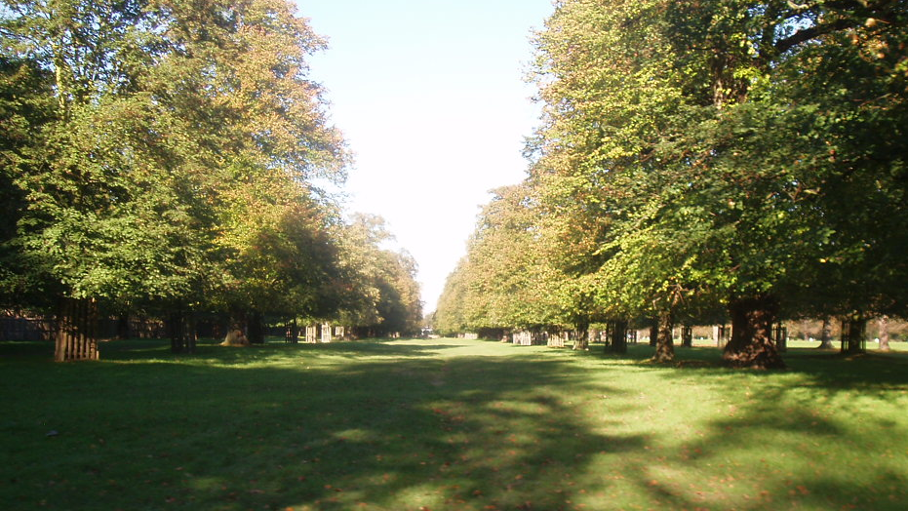
M.C.
“I got on fine. I went for my walk every morning at 7AM. I got a new phone as a present from my son and husband as my other one broke. When I went out walking, I kept away from most people and the streets were empty, no children were playing. I went to St. Ann's Park, Beaumont and all up the Malahide Road - I love walking, I think it was the best thing during lockdown.
I’m delighted I didn't have to cocoon but nobody came to my house. ”
This Photo by Unknown Author is licensed under CC BY-SA

Slide 5
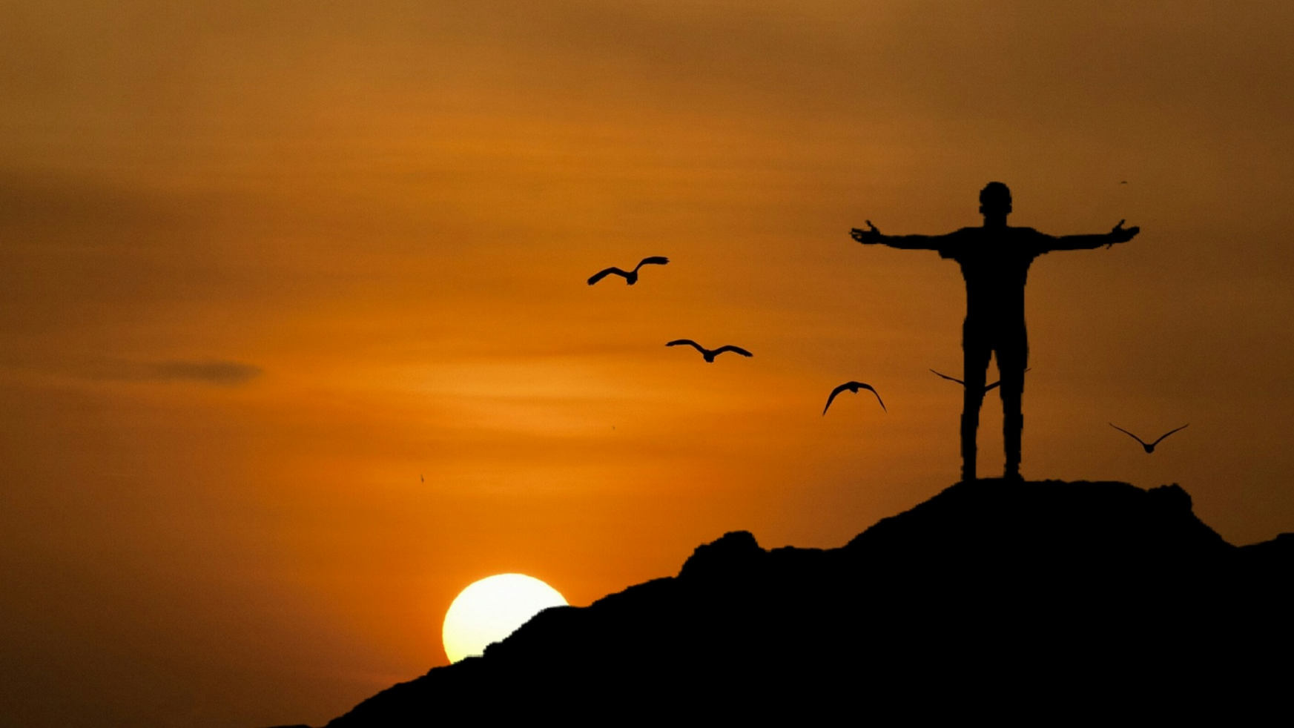
J.V.
“Having just reached a certain age, on March 19th, I had to cocoon for a few months. I found this extremely boring as I generally exercise a lot outdoors. It was a huge relief to be free again!
Thank God I can do a full workout again. It is vitally important for my good health”

Slide 6
M. E.
“Hi, on the lockdown, I always used my phone to get in touch with my children. I can't use my laptop because I have no internet. I’m very happy to see you back, thank you!
Thank you for your reply to my text. Every time I talk to my children and my granddaughter I am so happy ☺. Did u know what the day I resume college, was the day she resumed her school too? I was so happy to hear that she resumed to school.”
This Photo by Unknown Author is licensed under CC BY-NC-ND

Slide 7
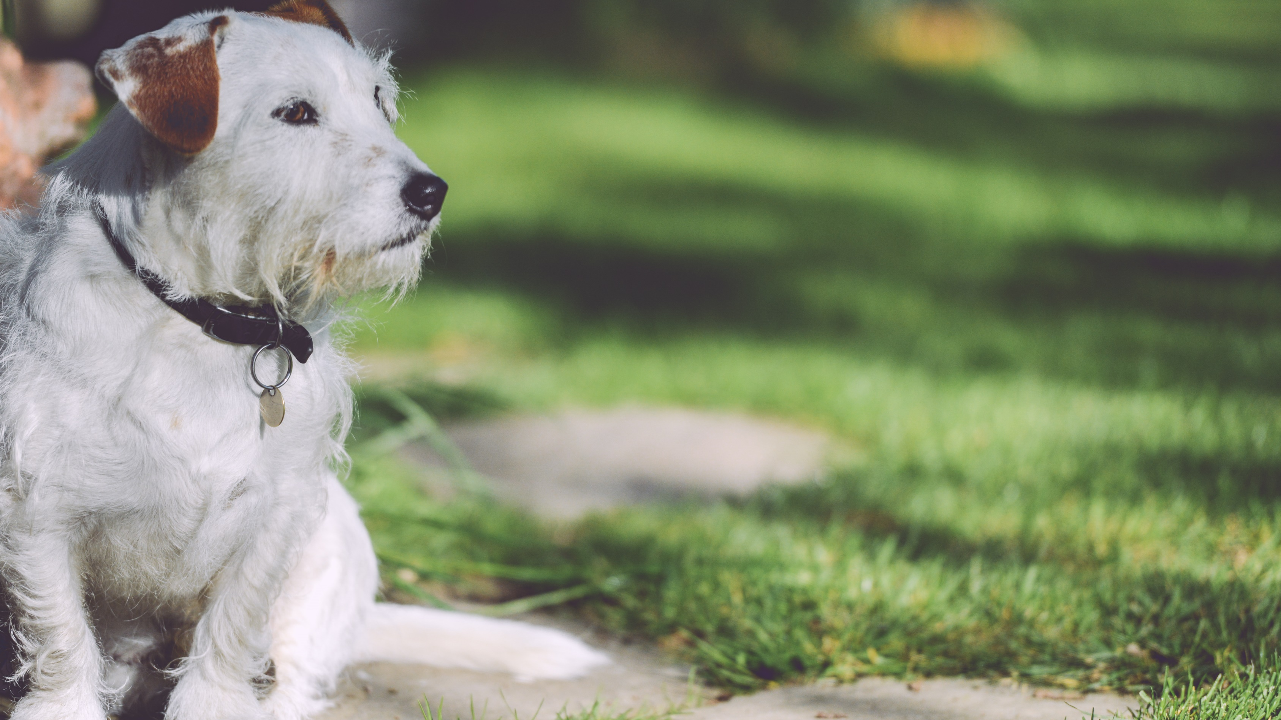
B. W.
“ went out walking with the dog every day just keep myself safe ”

Slide 8
H. M.
“how are you doing with this lock down? I am not doing good; I am so stressed because before I was not doing anything. I was just indoors, I have been thinking a lot. But now I am much better because I am attending college. ”
This Photo by Unknown Author is licensed under CC BY-SA

